Slide 1
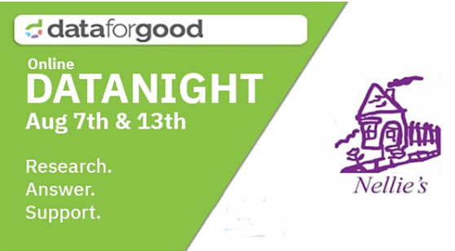

Slide 2

DATA IN THE SERVICE OF HUMANITY
Not-For-Profit Organizations Have data but lack the resources to mine it for valuable insights
Data Professionals & Enthusiasts Want to give back and improve their skills but lack the opportunities to do so
Notes:
The problem we’re trying to solve is two fold … on the one hand, many NFPs collect data (think operations, donations, etc) but lack the resources to mine it for insights. On the other hand, we have data professionals (like yourselves) who want to give back but lack the opportunities to do so. Our solution to both of these problems is simple; we organize (what we like to call) “datathons” where we bring together these 2 groups of people for mutual benefit. NFPs contribute data, Data professional contribute skills, awesome-ness occurs. And we can’t forget our Sponsors who keep the lights on.

Slide 3













PREVIOUS DATATHON PARTNERS
Notes:
Here are just some of the organization we’ve helped over the last 5 years. You’ll probably recognize some of the names up there (UNICEF, Greenpeace) and there’s probably some you may not have heard of before. The point here is we work with NFPs of all sizes and in all kinds of sectors, which means our members get to work on interesting and varied problems.

Slide 4
About Nellies Website
Nellie’s Mission is to operate programs and services for women and children who have and are experiencing oppressions such as violence, poverty and homelessness.
They are a community-based feminist organization which operates within an anti-racist, anti-oppression framework. They are committed to social change through education and advocacy, to achieve social justice for all women and children.

Slide 5
AGENDA – Aug 7th
Volunteer registration closes at 8PM August 7th with Nellies Private Data (Please send us your signed NDAs!!!)
Cleaned Access/Link to Google Drive Folder Census Data – 2016
Access to Slack Channel : “Nellies DataNight”
Video Recording from Nellies - briefly about what they expect out of the event/for motivation
Video Recording from Data For Good- How we used Nellies dataset to do a primary analysis and how users can extend on the work and submit results. Explanations about how to come prepared on Aug 13th with results for discussion on Aug 13th for the Sub-Questions
Notes:
Mention should have all received primer. How many people did research?
How many new people? How many been to a DataThon?

Slide 6
AGENDA – Aug 7th – 13th
1. Slack - At least one person from the team be available on all days to answer questions on Slack. Questions will be answered at least within 24-hours
2. On the day of Aug 13th - receive an email with Google Hangouts link to join in the evening Share the same info (with participant names/Hangout link they need to click on that day) to Slack Channel
Notes:
Mention should have all received primer. How many people did research?
How many new people? How many been to a DataThon?

Slide 7
Nellies Central Question
Which demographic do the individual donors at Nellie’s belong to?

Slide 8
Other Analysis Questions that Nellie’s is seeking an answer to:
Which gender do the top 10% of the donors belong to? (Hint: Nellie’s believe that male donors have increased considerably in the past few years. Can you help validate this hypothesis?)
What is the most-probable age-group these donors belong to?
What type of donation do the top 10% donors prefer? (Hint: filter by ‘Fund Description’ column in the Nellie’s data file. Maybe a relative frequency distribution viz here?)
What is the most common day/week/month of donation – are there any further insights that can be derived from this analysis?

Slide 9
Info about the Data we have
What info did Nellie’s share
Constituents.csv - consists of donor Information
Donations.csv - consists of donation information from 2000-2020
What you are going to work with
Constituents_Donations_Cleaned_joined.csv
name_gender.csv (reference not Nellie’s data)
Data_dic.txt - Data dictionary
Limitations:
Large chunk of Gender information is unknown
Age group of donors' data is not available

Slide 10
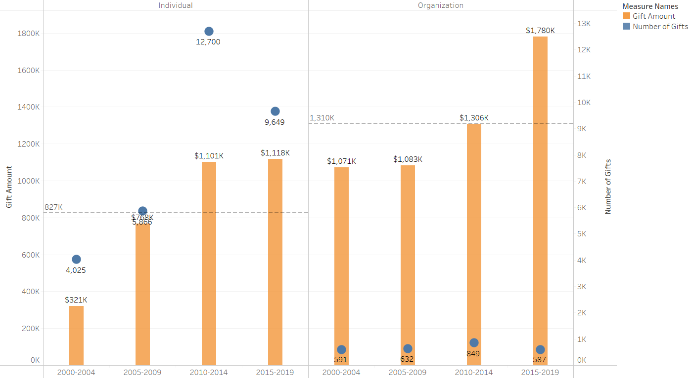
How has the donation grown?

Slide 11
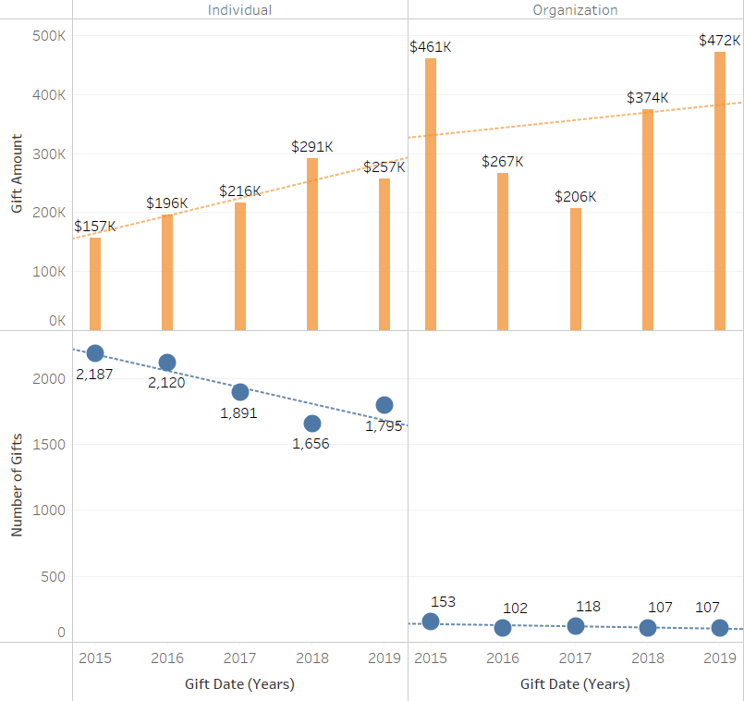
How has the donation grown in the past 5 years?
Donations value is steadily growing in spite of downward trend in number of donations by individuals

Slide 12
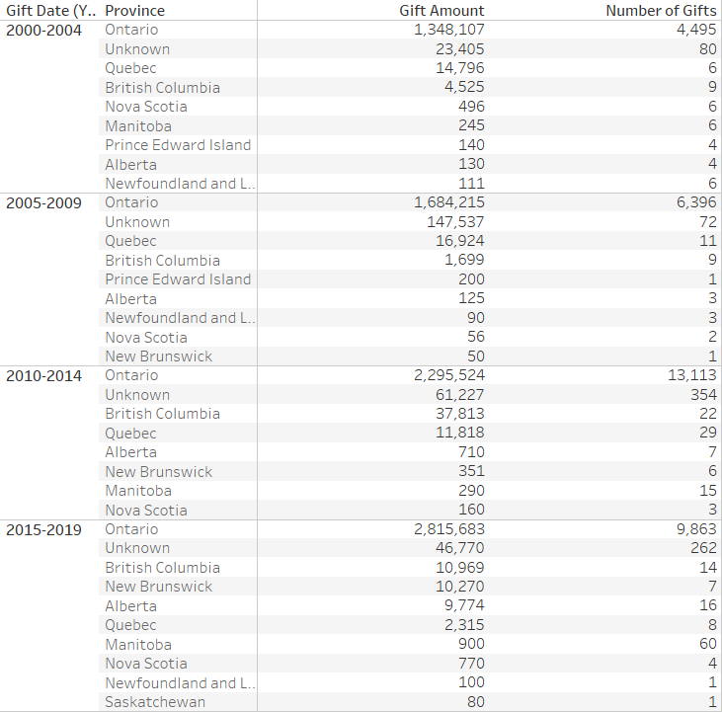
Largest contributing FSA in last 5 years
Ontario dominates the donations over the years

Slide 13
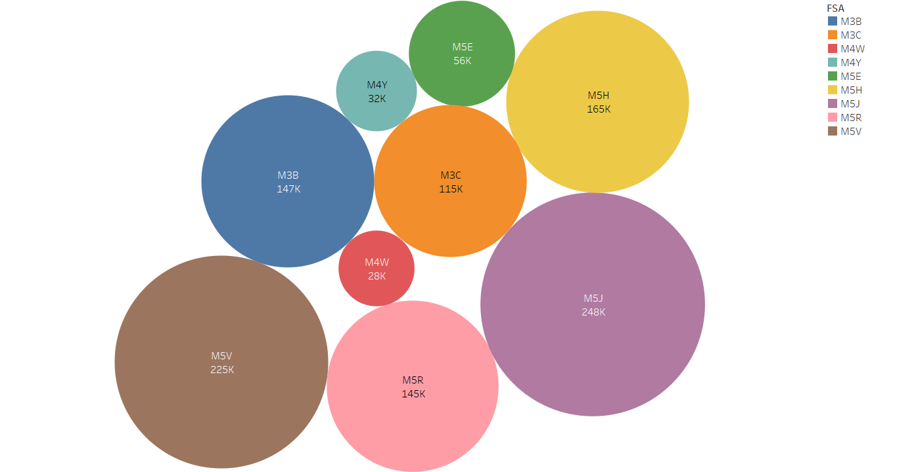
Largest contributing FSA in last 5 years
In last 5 year(2015-2019) largest contributor is FSA M5J followed by M5V and M5H. All the three FSA belong to Downtown Toronto

Slide 14
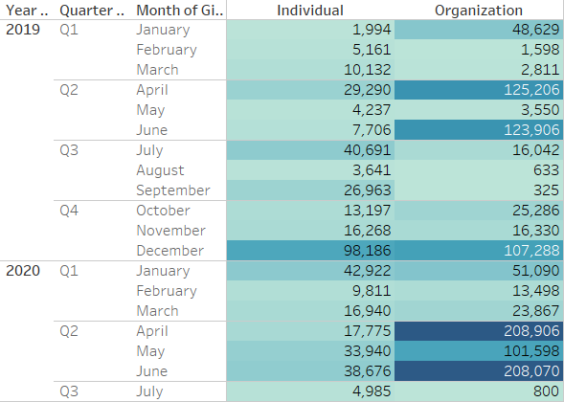
Which month of the year(most recent) does the donations peak?
Organizations are found to be generous in April and June whereas general population seems to be more generous during Holiday season (December)

Slide 15
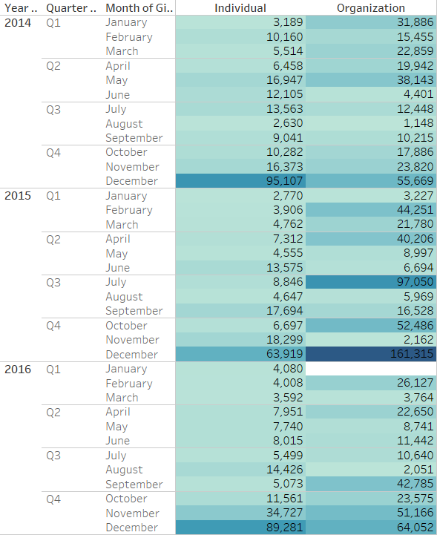
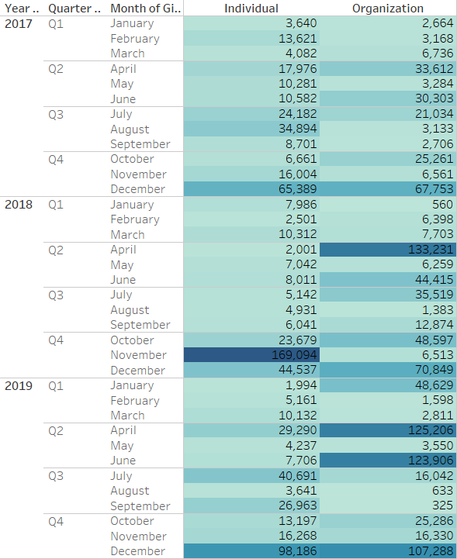
Which month of the year(past) does the donations peak?

Slide 16
AGENDA – Aug 13th
6:00PM: Event starts. Participants join their assigned groups
6:05PM to 6:45PM: Brainstorming Session to Discuss answers to Sub-questions. Group moderator makes notes
6:45PM-7:00PM: Google Forms Link (optional) & Google Hangouts Link
7:00PM-7:30PM: Final Meeting to reconvene results from Brainstorming Session
Notes:
Mention should have all received primer. How many people did research?
How many new people? How many been to a DataThon?

Slide 17
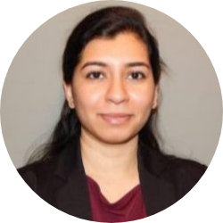
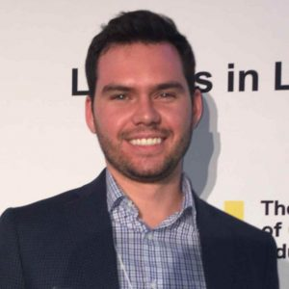
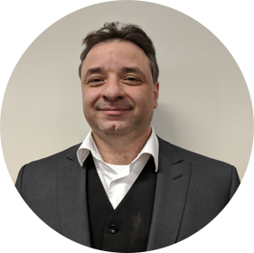
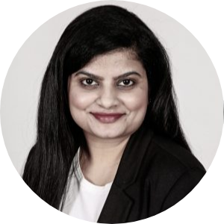
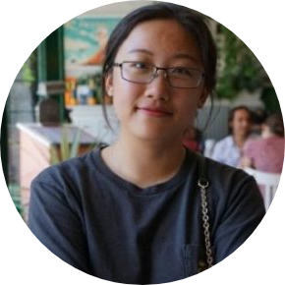
Group Moderators for August 13th
#1
#2
#3
Deepika
Jake
Jeff
#4
#5
Asha
Claire

Slide 18
Brainstorming
6:00-7:00
Discuss ideas for answering the Sub-Questions

Slide 19
“Which demographic do the individual donors at Nellie’s belong to?“
Brief Summary of Findings:
#1
#2
#3
#4
CENTRAL QUESTION
Send additional ideas to: toronto@dataforgood.ca or fill out the Google Forms

Slide 20
Based on the Demographic identified, what are the important KPIs that Nellie’s should focus on in the next 5 years in order to increase their donation trends?
SUB QUESTION #1
Send additional ideas to: toronto@dataforgood.ca or fill out the Google Forms

Slide 21
What are some easy-to-implement data-collection tools/strategies that could be used for collecting data going forward?
SUB QUESTION #2
Send additional ideas to: toronto@dataforgood.ca or fill out the Google Forms

Slide 22
What other data should Nellies be collecting in order to improve their operational efficiency and storytelling methodologies?
SUB QUESTION #3
Send additional ideas to: toronto@dataforgood.ca or fill out the Google Forms

Slide 23
One example of open source dataset that we could use to
analyze Nellie’s data is the Canadian Census Data. Can you think of other open-source datasets we could use for further analysis?
SUB QUESTION #4
Send additional ideas to: toronto@dataforgood.ca or fill out the Google Forms

Slide 24
Reconvene & Share Key Learnings, Ideas, Strategies
7:00-7:30
Group Moderators share what you discussed!

Slide 25
DOs & DONTs
DO:
Sign our Non-Disclosure Agreement (NDA) if you want to receive the data
Ask Questions on Slack Channel
Be respectful of the Data you receive
DON’T:
Upload any Private Data to Public Platforms. For example do not upload data/visualizations to Tableau Public or GitHub!

